Slide 1




Slide 2



Decode Your Team’s Colors: How Understanding Personality Drives Success
Speaker:
Nicole Banks of I AM Resource
AV Sponsor
Coffee Sponsor

Slide 3


Welcome & Thank You to Our Sponsors
AV Sponsor
Coffee Sponsors

Slide 4



DECODE YOUR TEAM’S COLORS:
HOW UNDERSTANDING PERSONALITY DRIVES SUCCESS
NICOLE R. BANKS

Slide 5



WHY DOES THIS MATTER?
  Improved Team Communication: Knowing each team member's temperament encourages clear and empathetic communication.
  Boosted Productivity: Organizations that embrace diverse temperaments see up to a 21% increase in overall team productivity.
  Reduced Turnover: Understanding team dynamics lowers turnover rates by 25%.
  Strengthened Leadership: Leaders who adapt to their team's temperaments demonstrate enhanced conflict resolution and emotional intelligence.
Effective communication starts with understanding, and understanding begins with recognizing how each person is uniquely wired.

Slide 6





MEET THE FOUR TEMPERMENTS
ACTION-ORIENTED
SOCIAL & SPONTANEOUS
ANALYTICAL & REFLECTIVE
STEADY & SUPPORTIVE
Goal-driven, assertive, and competitive. They thrive under pressure and prefer direct communication
Enthusiastic, optimistic, and outgoing. They excel in creative roles and are energized by social interaction
Detail-oriented, logical, and thoughtful. They value precision and need time to process information.
Calm, patient, and empathetic. They seek harmony and are excellent listeners.

Slide 7

HOW ARE YOU HARDWIRED?
Which color do you most identify with?
Red
Yellow
  I have thought through my decisions and have good reasons for them.
  ready to jump into new tasks, energized by challenges.
  I am confident and assertive with my opinion; I prefer to be in control.
  Unafraid to disagree with others.
  I am intelligent and capable of being serious when it's required
  I am excitable, passionate, and quick to say yes; I am energetic and lively I exhibit love and affection openly, and I am fun to be around.
  a good storyteller with a sense of humor
Blue
Green
  I am reserved, but I really do want to be invited and included.
  sensitive to the emotions of others, careful, thoughtful, don't rush into things, not confident in social situations.
  precise, thorough, has very high standards.
  I have ideas and opinions if I don't speak up, please ask.
  agreeable, easy to get along with
  avoids conflict and drama
  levelheaded
  I sometimes just want someone else to make the decision for me.

Slide 8

YOUR TEMPERMENT
Red
Yellow
Speaks the language of power and control
Extrovert/task oriented
Speaks the language of people and fun
Extrovert/people oriented
Blue
Green
Speaks the language of order and perfection
Introvert/ task oriented
Speaks the language of calm and harmony
Introvert/ people oriented
Extroverts direct their thoughts and feelings outward
and process their thoughts and feelings by speaking.
Introverts direct their thoughts and feelings inward
and process their thoughts and feelings before speaking.
(yellow & red)
(green & blue)
Notes:
Does this help you connect the dots with you?

Slide 9






POWERFUL
Strengths
Weaknesses
Can argue
Dynamic
Leaders
Good at delegating
Can dominate
Decisive
Excel at managing
Can use a harsh tone
Tend to be bossy
Responsible
Lead Projects
Can be impatient or intolerant
Uniquely wired to be visionaries who can see and achieve goals

Slide 10

RED
Innate Needs
  Being prioritized, knowing you had their back
  Everyone pulling their weight, following the plan
  Being valued for their unique strengths
  Being valued for their contributions
Loyalty
Sense of Control
Appreciation
Credit for Work
Sounds or looks like

Slide 11


LOUD
Strengths
Weaknesses
Can elaborate
Encouraging
Brings Joy
Can exaggerate
Inspiring
Laughter
Can speak too loudly
Can interupt others
Magnetic
Optimism
Has a tendency to be forgetful & naive
Uniquely wired to see the best in people and circumstances

Slide 12
YELLOW
  Being liked for who they are without needing to change.
  Being invited or included.
  Having your full focus, especially eye contact.
  Being noticed or acknowledged.
Innate Needs
Approval
Acceptance
Attention
Affection
Sounds or looks like

Slide 13


DEEP
Strengths
Weaknesses
Remember the Negatives
Detail Oriented
Compassionate
Fear of Failure
Creative
Artistic
Low Self-Esteem
Analytical
Musical
Tendency to be judgemental
Tendency to be critical
Uniquely wired to anticipate obstacles and creatively problem solve

Slide 14
BLUE
Innate Needs
  Being able to trust their surroundings and relationships
  Being understood
  Being offered or provided help
  Having time to decompress, process or think
Safety
Sensitivity
Support
Space & Silence
Sounds or looks like

Slide 15

PEACEFUL
Strengths
Weaknesses
Can be stubborn
Calm
Patient
Tendency to avoid conflict
Steady
Loyal friend
Can be disenaged
Easygoing
Good listener
Can be too compromising
Can shutdown from stress
Uniquely wired to stay calm and kind in the midst of chaos

Slide 16
GREEN
Innate Needs
  Everyone getting along or everything going smoothly
  being valued for their unique strengths
  an absence of conflict and combative words
  being asked for their thoughts or opinions
Harmony
Feeling of Worth
Lack of Stress
Respect
Sounds or looks like

Slide 17


TEMPERMENTS & TEAM SUCCESS
  Improved Communication: Tailoring communication styles reduces misunderstandings and creates a more positive environment.
  Enhanced Collaboration: Leverage each temperament’s strengths for a balanced team dynamic.
  Effective Conflict Resolution: Knowing emotional triggers allows leaders to mediate conflicts constructively.
  Better Engagement: Addressing innate needs (e.g., recognition, appreciation) boosts morale and commitment.

Slide 18

LEADING WITH AWARENESS
  Red team members appreciate clear, concise instructions and autonomy in executing tasks.
  Yellow team members respond well to praise, collaborative brainstorming, and recognition.
  Blue team members need structured, detailed communication and time for reflection.
  Green team members thrive in environments where harmony and mutual respect are prioritized.

Slide 19

APPLICATION
Scenario 1: Managing Conflict
Situation: A Red and Green team member clash in a meeting due to conflicting communication styles and priorities.
Strategy:
For the Red: Acknowledge their need for efficiency and control by ensuring decisions are made within a clear timeline.
For the Green: Provide reassurance and emphasize harmony by inviting their input and creating a calm discussion environment.

Slide 20

APPLICATION
Scenario 2: Leading Project Teams
Situation: Managing a project with a diverse team consisting of Red, Yellow, Blue, and Green temperaments.
Strategy:
  Assign roles based on strengths:
    Yellow: Lead team energizing and creative brainstorming.
    Blue: Handle detailed planning and logistics.
    Green: Manage team morale and cohesion.
    Red: Set goals and drive decision-making.

Slide 21

APPLICATION
Scenario 3: Enhancing Team Collaboration
Situation: Using temperament understanding to improve collaboration and engagement within the team.
Strategy:
  Have each member identify their temperament and share what support they need from others.
  Adjust communication and workflow to meet these needs, fostering a balanced and harmonious team dynamic.

Slide 22




KEY TAKEAWAYS
Understanding temperament is the first step to building effective teams.
Tailoring communication and engagement strategies to each temperament creates harmony and reduces conflict.
Success happens when we leverage each individual strengths.
STRATEGY N°1
STRATEGY N°2
STRATEGY N°3
Notes:
By mastering emotional regulation, we can lead ourselves and others with greater empathy and effectiveness. Thank you for exploring this essential aspect of leadership with me.

Slide 23
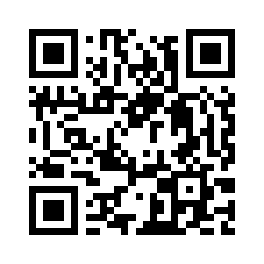
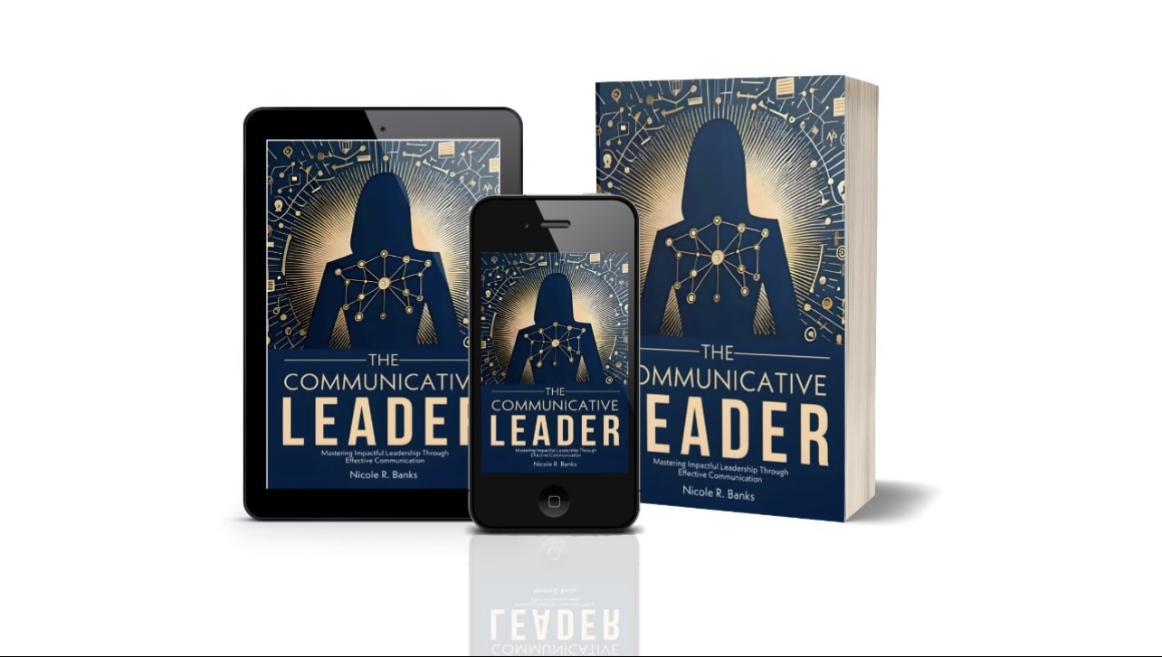
STAY CONNECTED
SCAN THE QR CODE TO CONNECT
A FEW COPIES AVAILABLE
Notes:
By mastering emotional regulation, we can lead ourselves and others with greater empathy and effectiveness. Thank you for exploring this essential aspect of leadership with me.

Slide 24
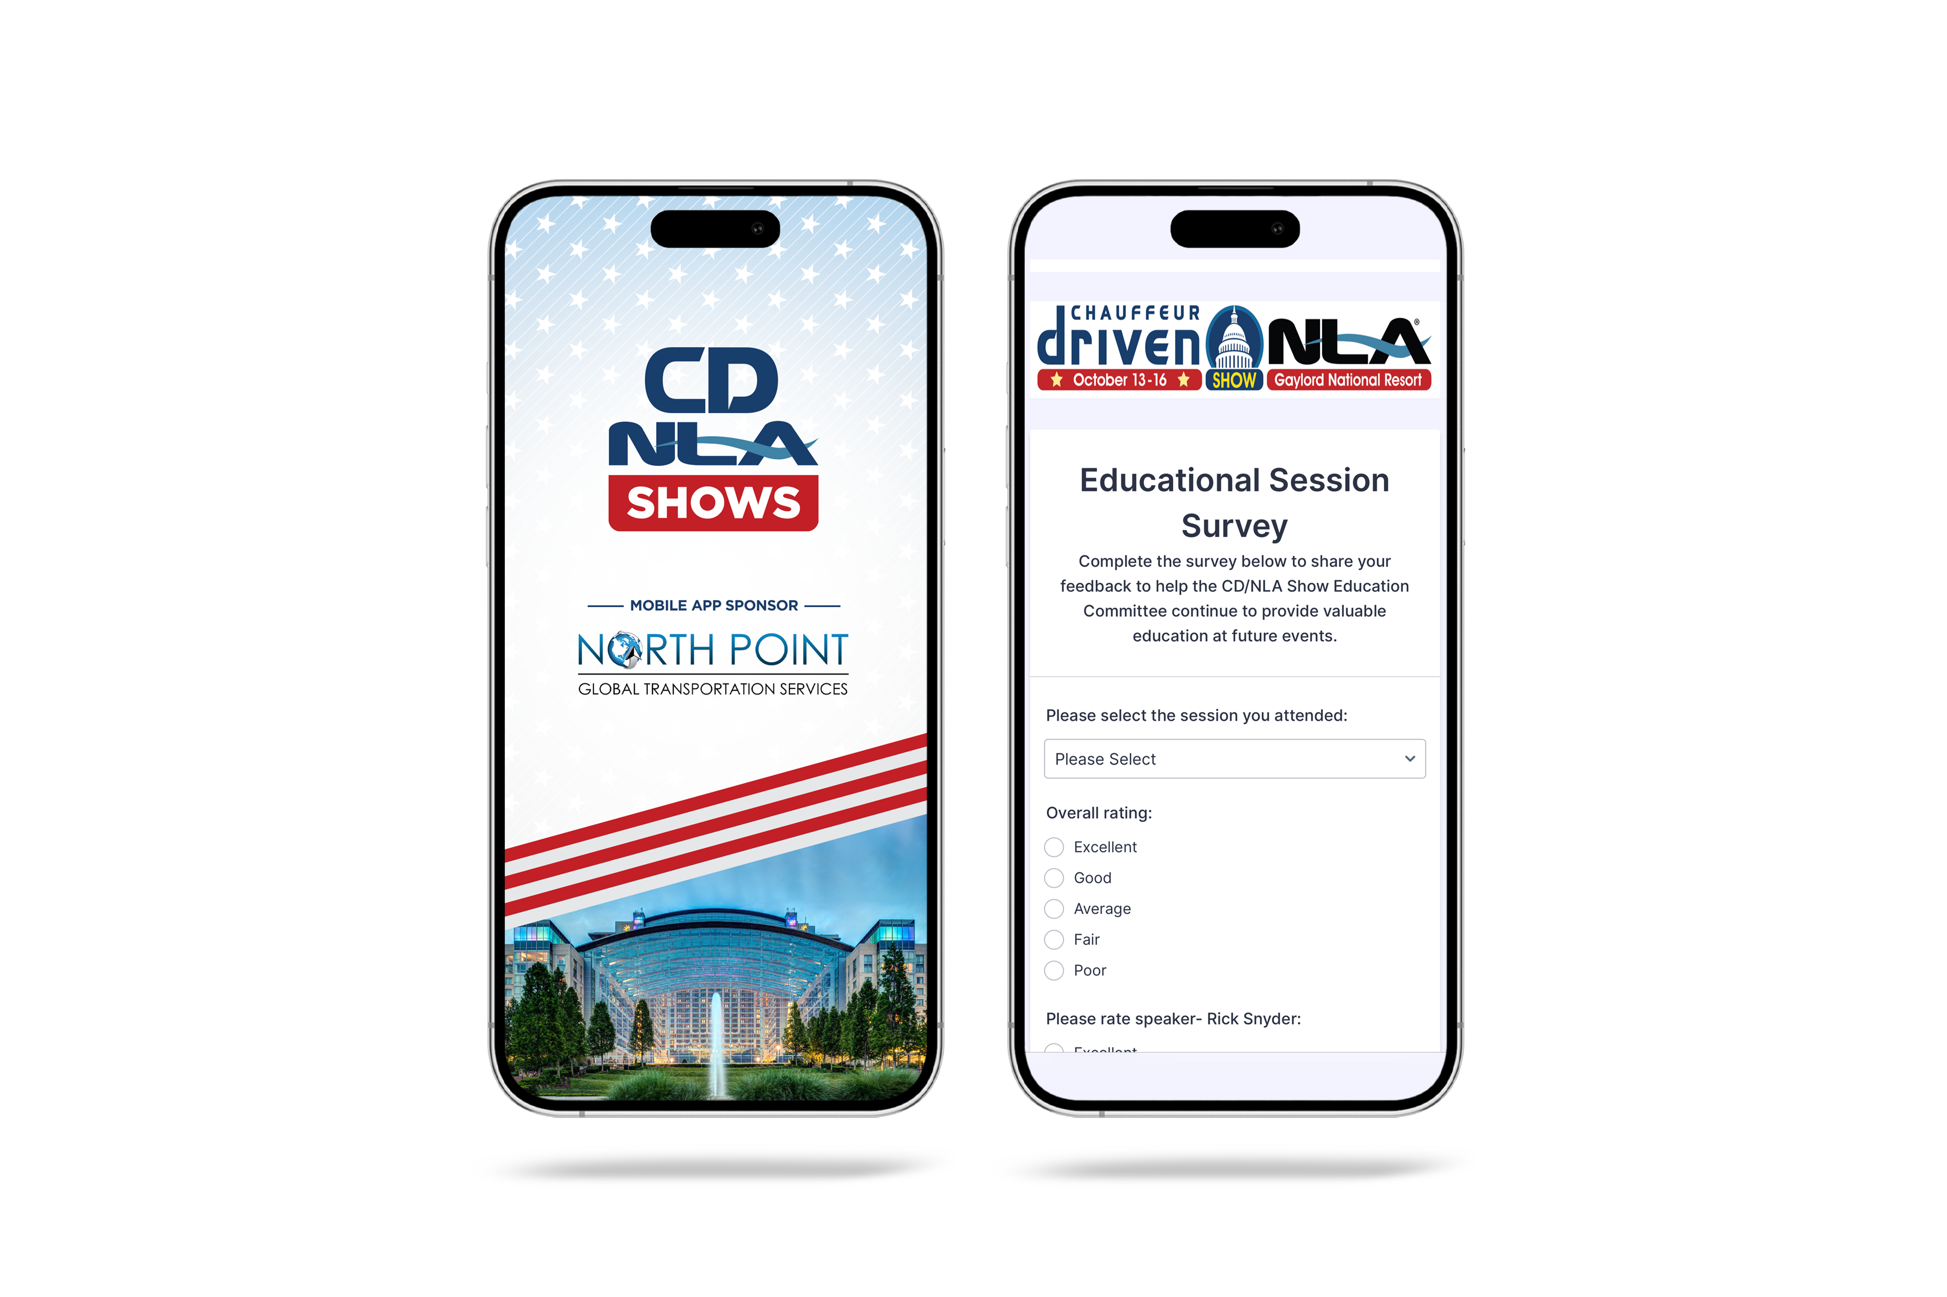
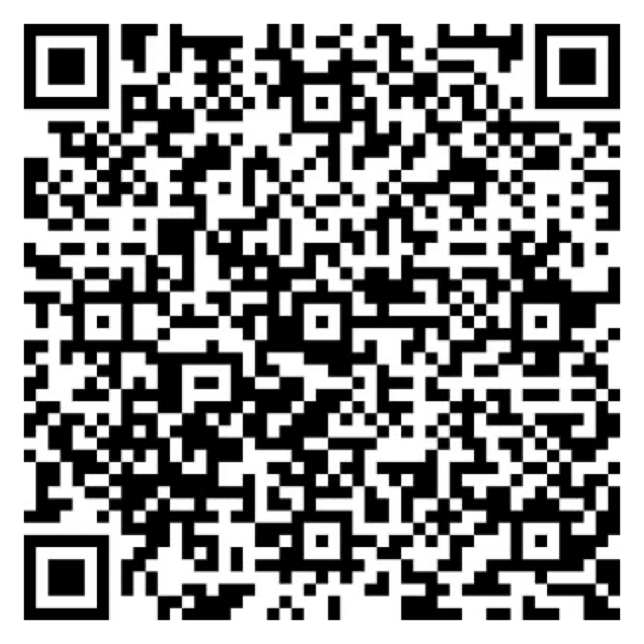

Let Us Know How
We Did!
Fill Out the Survey
AV Sponsor
Coffee Sponsor

Slide 25
Thank You for Joining Us!
AV Sponsor
Coffee Sponsor

